Slide 1
Jagran Institute Of Management
Department of MCA
MASTER OF COMPUTER APPLICATION
(Second Year-2025-26-Semester:4th )
BMC-035-Software Quality Engineering
Subject Start Date: 2nd February-2026
Name of Faculty:
Vishnu Kr. Shukla
(Assistant Professor )
Department of MCA

Slide 2


Slide 3
UNIT-V-
Start-

Slide 4
UNIT-V-
Software Verification, Validation & Testing:
Verification and Validation, Evolutionary Nature of Verification and Validation, Impracticality of Testing all Data and Paths, Software Testing, Proof of Correctness, Functional, Structural and Error-Oriented Analysis & Testing, Static and Dynamic Testing Tools, Characteristics of Modern Testing Tools.

Slide 5
Introduction to Software Verification:
Software verification is a discipline of software engineering whose goal is to assure that software fully satisfies all the expected requirements.
Verification in Software Testing is a process of checking documents, design, code, and program in order to check if the software has been built according to the requirements or not. The main goal of verification process is to ensure quality of software application, design, architecture etc

Slide 6
What is Software Verification? Reviewing of any software for the purpose of finding faults is known as software verification. Verification is the process of checking that a software achieves its goal without any bugs.
It is the process to ensure whether the product that is developed is right or not. The reviewing of a document can be done from the first phase of software development i.e. software requirement and analysis phase where the end product is the SRS document.
There are many methods for practicing the verification of the software like peer reviews, walkthroughs, inspections, etc that can help us in the prevention of potential faults otherwise, it may lead to the failure of software.

Slide 7
The Secret Code of Software Validation in 5 Steps
Step 1: Create the Validation Plan. ...
Step 2: Define System Requirements. ...
Step 3: Create the Validation Protocol & Test Specifications. ...
Step 4: Testing. ...
Step 5: Develop/Revise Procedures & Final Report.

Slide 8
Methods of Verification :
Peer Reviews – The very easiest method and informal way of reviewing the documents or the programs/software for the purpose of finding out the faults during the verification process is the peer-review method.
In this method, we give the document or software programs to others and ask them to review those documents or software programs where we expect their views about the quality of our product and also expect them to find the faults in the program/document.
The activities that are involved in this method may include SRS document verification, SDD verification, and program verification. In this method, the reviewers may also prepare a short report on their observations or findings, etc.

Slide 9
2. Walk-through – Walk-throughs are the formal and very systematic type of verification method as compared to peer-review. In a walkthrough, the author of the software document presents the document to other persons which can range from 2 to 7. Participants are not expected to prepare anything.
The presenter is responsible for preparing the meeting. The document(s) is/are distributed to all participants. At the time of the meeting of the walk-through, the author introduces the content in order to make them familiar with it and all the participants are free to ask their doubts.

Slide 10
3. Inspections – Inspections are the most structured and most formal type of verification method and are commonly known as inspections. A team of three to six participants is constituted which is led by an impartial moderator.
Every person in the group participates openly, actively, and follows the rules about how such a review is to be conducted.
Everyone may get time to express their views, potential faults, and critical areas. After the meeting, a final report is prepared after incorporating necessary suggestions by the moderator.

Slide 11
Hence, Verification is likely more effective than validation but it may find some faults that are somewhat impossible to find during the validation process. But at the same time, it allows us to find faults at the earliest possible phase/time of software development.
Another Point of view types of verification:-
1. Verification by Test
2. Verification by Demonstration
3. Verification by Analysis
4. Verification by Inspection

Slide 12
Broad scope and classification:-
A broad definition of verification makes it equivalent to software testing. In that case, there are two fundamental approaches to verification:
Dynamic verification, also known as experimentation, dynamic testing or, simply testing. - This is good for finding faults (software bugs).
Static verification, also known as analysis or, static testing -
This is useful for proving the correctness of a program. Although it may result in false positives when there are one or more conflicts between the process a software really does and what the static verification assumes it does.

Slide 13
Dynamic verification (Test):-
Dynamic verification is performed during the execution of software, and dynamically checks its behavior; it is commonly known as the Test phase. Verification is a Review Process. Depending on the scope of tests, we can categorize them in three families:
Test in the small: a test that checks a single function or class (Unit test)
Test in the large: a test that checks a group of classes, such as
Module test (a single module)
Integration test (more than one module)
System test (the entire system)
Acceptance test: a formal test defined to check acceptance criteria for a software
Functional test
Non functional test (performance, stress test)
The aim of software dynamic verification is to find the errors introduced by an activity (for example, having a medical software to analyze bio-chemical data); or by the repetitive performance of one or more activities (such as a stress test for a web server, i.e. check if the current product of the activity is as correct as it was at the beginning of the activity)

Slide 14
Static verification (Analysis)
Static verification is the process of checking that software meets requirements by inspecting the code before it runs. For example:
Code conventions verification
Bad practices (anti-pattern) detection
Software metrics calculation
Formal verification
Verification by Analysis - The analysis verification method applies to verification by investigation, mathematical calculations, logical evaluation, and calculations using classical textbook methods or accepted general use computer methods. Analysis includes sampling and correlating measured data and observed test results with calculated expected values to establish conformance with requirements.

Slide 15
OR -Verification: Verification is the process of checking that a software achieves its goal without any bugs. It is the process to ensure whether the product that is developed is right or not. It verifies whether the developed product fulfills the requirements that we have. Verification is Static Testing.
Activities involved in verification:
Inspections
Reviews
Walkthroughs
Desk-checking

Slide 16
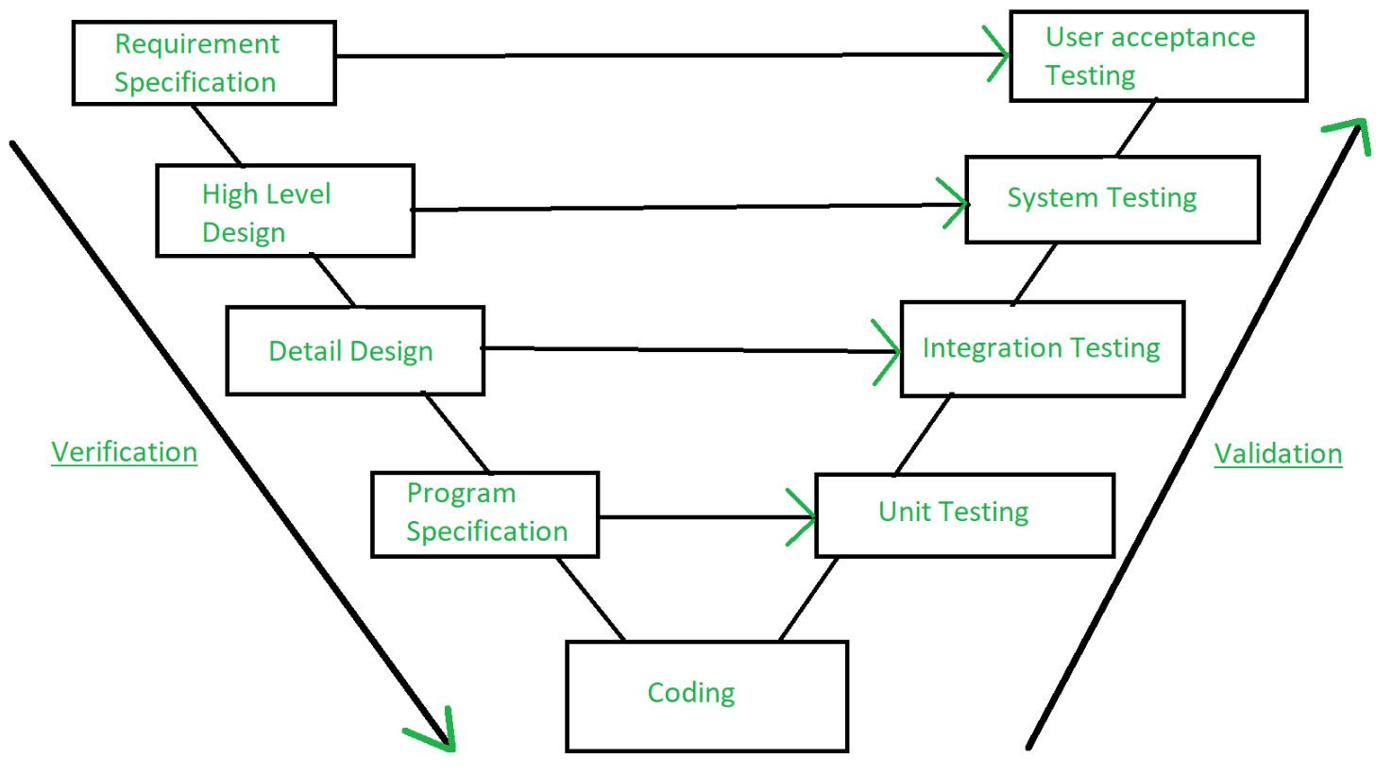

Slide 17
Introduction to Software Validation:- Validation is the process of checking whether the software product is up to the mark or in other words product has high level requirements. It is the process of checking the validation of product i.e. it checks what we are developing is the right product. it is validation of actual and expected product. Validation is the Dynamic Testing.
Activities involved in validation:
Black box testing
White box testing
Unit testing
Integration testing
Note: Verification is followed by Validation.

Slide 18
In short (Methods Or approaches of Software verification)
The process of software verification can be performed through following approaches:
Reviews: It is an organized way of examining the documents such as design specifications, requirements specifications, code, etc. by one or more than one person, to explore defects in the software.
Walkthroughs: It is, usually an informal way of evaluating the software product, where different teams, whether associated or non-associated with the software development, goes through the software product and have discussion on possible errors and other defects, present in the software.
Inspection: It is one of the preferred and most common methods of the static testing.
Unlike, walkthroughs, it's a formal way of testing the software, through examination of documents, carried out by the skilled moderator. This method usually, checklist, rules, entry & exist criteria along with preparation and sharing of reports, in order to take corrective & necessary actions.

Slide 19
Advantages of Software Verification:
The advantages offered by software verification are numerous. It is among those processes, which makes the process of software development easy and allows the team to create an end product that conforms to the rules and regulations, as well as customer’s requirements. Other advantages of this process are:
It helps reduce the number of defects found during the later stages of development.
Verifying the software in its initial development phase allows the team to get a better understanding of the product.
It helps reduce the chances of system failures and crashes.
Assists the team in developing a software product that conforms to the specified requirements and design specifications.

Slide 20
Introduction to Software Validation:
Software Validation plays an immensely significant role during the software development life cycle (SDLC) and helps the testing and development teams to create a quality product. Therefore, in this article, we shall discuss the various aspects of software validation.
The process of evaluating software during or at the end of the development process to determine whether it satisfies specified requirements.
The process of evaluating software during the development process or at the end of the development process to determine whether it satisfies specified business requirements.
Validation Testing ensures that the product actually meets the client's needs. It can also be defined as to demonstrate that the product fulfills its intended use when deployed on appropriate environment.

Slide 21
Or - What is Software Validation?
Software Validation is a process of evaluating software product, so as to ensure that the software meets the pre-defined and specified business requirements as well as the end users/customers' demands and expectations.
It is basically, performed with the intent to check that whether the developed software is built as per pre-decided software requirement specifications (SRS) and if it caters to fulfill the customers' actual needs in the real environment.
Both, the verification and validation is a software testing activity, and verification is followed by the validation. Validation is usually carried out at the end of the software development.

Slide 22
Software Validation Procedure:
As stated earlier, validation is the actual testing performed on the software product. Thus, it requires proper testing strategy. According to ISO/IEC 12207:2008, validation process includes:
Gathering and analysis of the specifications and requirements.
Based on specifications and requirements, preparation of test strategies, plans and cases, that seems fit for use.
Go for testing the boundary values along with stress and functionalities test.
Test the error message.
Conducts software evaluation, as it ensures that the software meets the all pre-decided requirements and is acceptable for use.

Slide 23
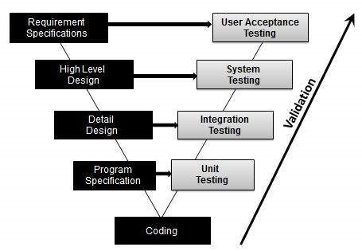
Activities:
Unit Testing
Integration Testing
System Testing
User Acceptance Testing

Slide 24
Difference Between Software Verification and Validation:
Software verification and validation are two of the most important processes used for ensuring the quality and accuracy of the product.
However, these are usually confused by people and used interchangeably.
Hence, to help you here is a comparison between these two software testing techniques.

Slide 25
Software Verification | Software Validation
1. Software verification is the process of evaluating the development phase to ensure the accuracy of the software. | 1. Software validation evaluates the software during the development phase to ensure its compliance with business requirements.
2. It is performed before the execution of software validation. | 2. It is performed once the process of software verification is completed.
3. Verification ensures the product is being developed as per the requirements and design specification. | 3. Validation ensures that the software meets the user’s needs and is fit to be used by them.
4. Evaluates plans, requirement specification, documents, test cases, etc. | 4. Evaluates the software product to verify its readiness to be released.

Slide 26
Software Verification and Validation(V & V )
Verification and validation assure that a software system meets a user's needs.
Verification:
"Are we building the product right?"
The software should conform to its specification.
Validation:
"Are we building the right product?"
The software should do what the user really requires.

Slide 27
Why Software Validation is Required?
From ensuring the fulfillment of particular requirements of a specific intended use to investigating any deviations from the established parameters, there are various reasons for performing software validation. Other reasons for implementing software validation are:
It ensures that the software has been built in conformance with the requirements of the customer.
Helps catch errors that were missed or overlooked during the software verification.
Enables the team to build a software that fulfils users requirements.
Execution of code comes under software validation.
Helps improve the quality and value of the software product.

Slide 28
Evolutionary validation, verification and certification:
(Enabling iterative and incremental development of certified software)
Reliable, accurate, fast and low-cost validation and verification of software products is a cornerstone of modern high-tech industry. The EVOLVE project will enforce the creation of a methodological framework for early verification and validation of evolutionary software products through the accredited and certified integration of each component during every iteration in an incremental model-driven engineering (MDE) context.

Slide 29
Concept of Evolutionary model is a combination of Iterative and Incremental model of software development life cycle. Delivering your system in a big bang release, delivering it in incremental process over time is the action done in this model. Some initial requirements and architecture envisioning need to be done.
It is better for software products that have their feature sets redefined during development because of user feedback and other factors.
The Evolutionary development model divides the development cycle into smaller, incremental waterfall models in which users are able to get access to the product at the end of each cycle.

Slide 30
Evolutionary model suggests breaking down of work into smaller chunks, prioritizing them and then delivering those chunks to the customer one by one. The number of chunks is huge and is the number of deliveries made to the customer. The main advantage is that the customer’s confidence increases as he constantly gets quantifiable goods or services from the beginning of the project to verify and validate his requirements. The model allows for changing requirements as well as all work in broken down into maintainable work chunks.
Application of Evolutionary Model:
It is used in large projects where you can easily find modules for incremental implementation. Evolutionary model is commonly used when the customer wants to start using the core features instead of waiting for the full software.
Evolutionary model is also used in object oriented software development because the system can be easily portioned into units in terms of objects.

Slide 31
Advantages of Evolutionary Model:
In evolutionary model, a user gets a chance to experiment partially developed system.
It reduces the error because the core modules get tested thoroughly.
Disadvantages of Evolutionary Model:
Sometimes it is hard to divide the problem into several versions that would be acceptable to the customer which can be incrementally implemented and delivered.

Slide 32
Proof of correctness
What is-Proof of Correctness in software engineering?
In software engineering, the correctness of a program or system is achieved if it behaves exactly as intended for all of its use-cases.
Before software is developed, engineers craft a list of specifications that their system must adhere to in order to achieve correctness. Without achieving correctness, a system is not ready for use, as it might be unsafe or incomplete.
DEFINITION:-
Proof of correctness in software quality ensures a program's output meets its specific requirements through mathematical verification. It goes beyond testing by formally proving the program's behavior, guaranteeing it functions as intended under all specified conditions. This process involves using formal logic and mathematical reasoning to demonstrate that the code is free from errors and that its output is consistent with the initial design.

Slide 33
OR-Proof of correctness in software quality refers to a mathematical approach to demonstrate that a program or part of it will produce the correct results when executed, fulfilling specific requirements. It's a formal verification method that aims to provide assurance about software's behavior by rigorously proving its correctness based on a defined specification.
Key aspects of proof of correctness:
Mathematical Verification:
Correctness proofs utilize formal methods and mathematical reasoning to prove that a program's output is accurate and consistent with its specifications.
Formal Logic:
Proving correctness often involves using formal logic to express the program's behavior and properties in a way that can be mathematically verified.
Specifications:
A clear and precise specification is crucial for correctness proofs, defining the expected input, output, and behavior of the program.

Slide 34
Preconditions and Post conditions: Correctness proofs often rely on preconditions (conditions that must be true before the program executes) and post conditions (conditions that must be true after the program executes) to ensure the program behaves as expected.
Beyond Testing: Proofs of correctness go beyond traditional testing, which relies on examining a limited set of inputs and outputs. They provide a more comprehensive guarantee of the program's accuracy.
Types of Proofs: Different techniques can be used for correctness proofs, including induction, formal verification tools, and program extraction from proofs.
Benefits: Proving correctness can lead to more reliable and robust software, especially in critical systems where even a small error can have significant consequences.
In essence, proof of correctness is a formal process of verifying that a software program, or a part thereof, will produce the correct results under specified conditions, providing a higher degree of confidence in the software's reliability than testing alone.

Slide 35
Establishing correctness of Software:-
We can establish correctness via rigorous software verification and testing. The brute-force method would be to test the system with a wide range of inputs and detect erroneous output if any exists.
Alternatively, we can prove correctness via mathematical reasoning or proof. Unfortunately, it is hard to automate the process of establishing correctness.

Slide 36
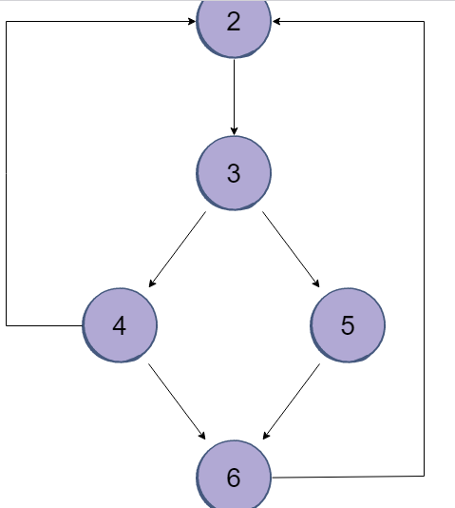
Control flow testing:-
One way to prove program correctness is to determine the control flow path(s) that a program takes while executing via path coverage.
The program must traverse through a certain control flow path to achieve correctness. If the path taken by the program is identical to the correct path, we can deduce that the program has performed the corresponding task correctly.

Slide 37
(In Another Point of view)
What is-Proof of Correctness in Software Testing:-
A proof of correctness is a mathematical proof that a computer program or a part there of will, when executed, yield correct results i.e., results fulfilling specific requirements. Before proving a program correct, the theorem to be proved must, of course, be formulated.
Hypothesis: The hypothesis of such a correctness theorem is typically a condition that the relevant program variables must satisfy immediately “before” the program is executed. This condition is called the “precondition”.
Thesis: The thesis of the correctness theorem is typically a condition that the relevant program variables must satisfy immediately “after” execution of the program. This latter condition is called the ‘post-condition’.

Slide 38
Thus the correctness theorem can be stated as:
“If the condition, “V”, is true before execution of the program, “S”, then the condition, “P”, will be true after execution of “S” “.
Where “V” is pre-condition and “P” is post-condition.
Notation:
Such a correctness theorem is usually written as {V} S {P}, where V, S and P have been explained above.
By “program variable” we broadly include input and output data, e.g., data entered via a keyboard, displayed on a screen or printed on paper. Any externally observable aspect of the program’s execution may be covered by the precondition and post-condition.

Slide 39
Software Testing Tools:-
Software Testing tools are the tools which are used for the testing of software. Software testing tools are often used to assure firmness, thoroughness and performance in testing software products.
Unit testing and subsequent integration testing can be performed by software testing tools. These tools are used to fulfill all the requirements of planned testing activities.
These tools also works as commercial software testing tools. The quality of the software is evaluated by software testers with the help of various testing tools.

Slide 40
Types of Testing Tools: As software testing is of two types, static testing and dynamic testing. Also the tools used during these testing are named accordingly on these testing's. Testing tools can be categorized into two types which are as follows:
1. Static Test Tools 2. Dynamic Test Tools
These are explained in detail as following below:
1. Static Test Tools: Static test tools are used to work on the static testing processes. In the testing through these tools, typical approach is taken. These tools do not test the real execution of the software. Certain input and output are not required in these tools. Static test tools consists of the following:
Flow analyzers: Flow analyzers provides flexibility in data flow from input to output.
Path Tests: It finds the not used code and code with inconsistency in the software.
Coverage Analyzers: All rationale paths in the software are assured by the coverage analyzers.
Interface Analyzers: They check out the consequences of passing variables and data in the modules.

Slide 41
2. Dynamic Test Tools: Dynamic testing process is performed by the dynamic test tools. These tools test the software with existing or current data. Dynamic test tools comprises of the following:
Test driver: Test driver provides the input data to a module-under-test (MUT).
Test Beds: It displays source code along with the program under execution at the same time.
Emulators: Emulators provides the response facilities which are used to imitate parts of the system not yet developed.
Mutation Analyzers: They are used for testing fault tolerance of the system by knowingly providing the errors in the code of the software.

Slide 42
Introduction to functional testing:-
Functional testing is a type of testing that seeks to establish whether each application feature works as per the software requirements.
Each function is compared to the corresponding requirement to ascertain whether its output is consistent with the end user's expectations.
Functional testing is the process through which QAs determine if a piece of software is acting in accordance with pre-determined requirements. It uses black-box testing techniques, in which the tester has no knowledge of the internal system logic.
Functional testing is only concerned with validating if a system works as intended.

Slide 43
What is Functional Testing?
FUNCTIONAL TESTING is a type of software testing that validates the software system against the functional requirements/specifications. The purpose of Functional tests is to test each function of the software application, by providing appropriate input, verifying the output against the Functional requirements.
Functional testing mainly involves black box testing and it is not concerned about the source code of the application. This testing checks User Interface, APIs, Database, Security, Client/Server communication and other functionality of the Application Under Test. The testing can be done either manually or using automation.

Slide 44
What do you test in Functional Testing?
The prime objective of Functional testing is checking the functionalities of the software system. It mainly concentrates on –
Mainline functions: Testing the main functions of an application
Basic Usability: It involves basic usability testing of the system. It checks whether a user can freely navigate through the screens without any difficulties.
Accessibility: Checks the accessibility of the system for the user
Error Conditions: Usage of testing techniques to check for error conditions. It checks whether suitable error messages are displayed.

Slide 45
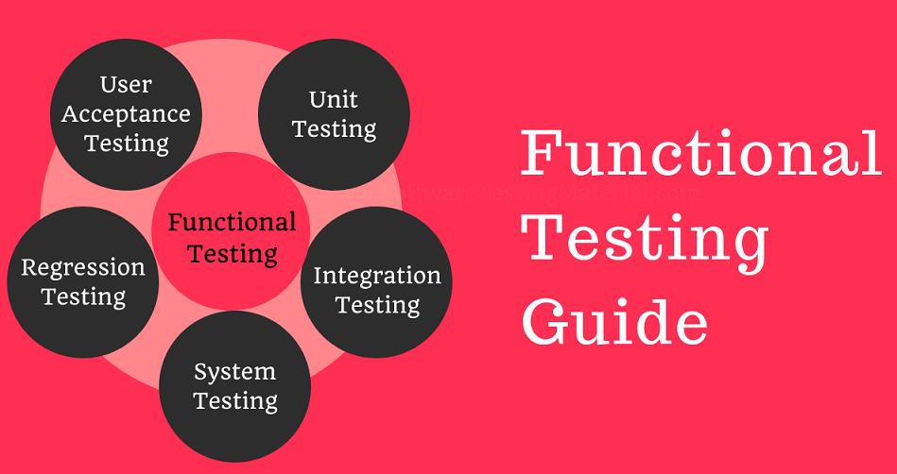
Functional testing types
Unit testing.
Component testing.
Smoke testing.
Regression testing.
Integration testing.
API testing.
UI testing.

Slide 46
1. Unit Testing: This is performed by developers who write scripts that test if individual components/units of an application match the requirements. This usually involves writing tests that call the methods in each unit and validate them when they return values that match the requirements.
In unit testing, code coverage is mandatory. Ensure that test cases exist to cover the following:
Line coverage
Code path coverage
Method coverage
2. Smoke Testing: This is done after the release of each build to ensure that software stability is intact and not facing any anomalies.
3. Sanity Testing: Usually done after smoke testing, this is run to verify that every major functionality of an application is working perfectly, both by itself and in combination with other elements.

Slide 47
Regression Testing: This test ensures that changes to the codebase (new code, debugging strategies, etc.) do not disrupt the already existing functions or trigger some instability.
Integration Testing: If a system requires multiple functional modules to work effectively, integration testing is done to ensure that individual modules work as expected when operating in combination with each other. It validates that the end-to-end outcome of the system meets these necessary standards.
Beta/ Usability Testing: In this stage, actual customers test the product in a production environment. This stage is necessary to gauge how comfortable a customer is with the interface. Their feedback is taken for implementing further improvements to the code.

Slide 48
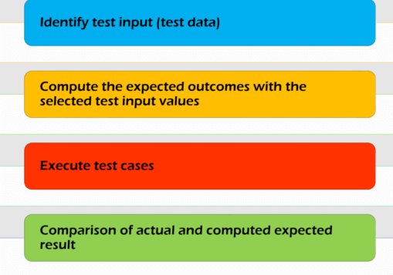

Process Workflow for Functional Testing:-
The overview of a functional test includes the following steps:
Create input values
Execute test cases
Compare actual and expected output

Slide 49
Generally, functional testing in detail follows the steps below:
Determine which functionality of the product needs to be tested. This can vary from testing main functions, messages, error conditions and/or product usability.
Create input data for functionalities to be tested according to specified requirements.
Determine acceptable output parameters according to specified requirements.
Execute test cases.
Compare actual output from the test with the predetermined output values. This reveals if the system is working as expected.

Slide 50
Introduction of Structural Testing:-
Another type of software testing technique is Structural testing, which is used to test the internal design of the software or structure of the coding for the particular software.
In this testing, the development team members are included in the testing team to execute the software's internal design. The working of structural testing is opposite to Behavioral testing.
In other words, we can say that structural testing tests the different features of an application based on its types.
Structural testing is also known as white-box testing, glass box testing, and clear-box testing. Developers mostly implement it to identify the issue and fix them quickly.

Slide 51
The structural testing process requires an in-depth knowledge of the programming language and is opposite to Functional Testing.
The knowledge of the code's internal executions and how the software is implemented is a necessity for the test engineer to implement the structural testing.
Throughout the structural testing, the test engineer intends on how the software performs, and it can be used at all levels of testing.
For example, the coverage of menu options or significant business transactions could be the system's structural element or acceptance testing.

Slide 52
What are the Characteristics of Structural Testing? Structural testing, white box testing or glass box testing has the following characteristics:
Structural testing requires the knowledge of internal coding of the software and the basics. Thus, the testing can only be carried out by a member of the developer team who knows how the software was designed.
The structural testing is based on how the system carries out the operations instead of how it is perceived by the users or how functions are carried out.
The structural testing provides better coverage than many of the testing approaches as it tests the whole code in detail, and the errors involved can easily be removed. The chances of missing out on any error become very low.
Structural testing can be carried out at various levels, from high to low, which involves the whole detailed testing of the system. It can complement the functional testing.

Slide 53
Error Handling Software Testing:-Error handling testing is a type of software testing that is performed to check whether the system is capable of or able to handle the errors that may happen in future. This type of testing is basically performed with the help of both developers and the testers. Error handling testing not only focuses on the determination of error but also focuses on the exception handling.
Objective of Error Handling Testing: The objective of error handling testing is:
To check the system ability to handle errors.
To check the system highest soak point.
To make sure errors can be handles properly by the system in the future.
To make system capable of exception handling also.

Slide 54
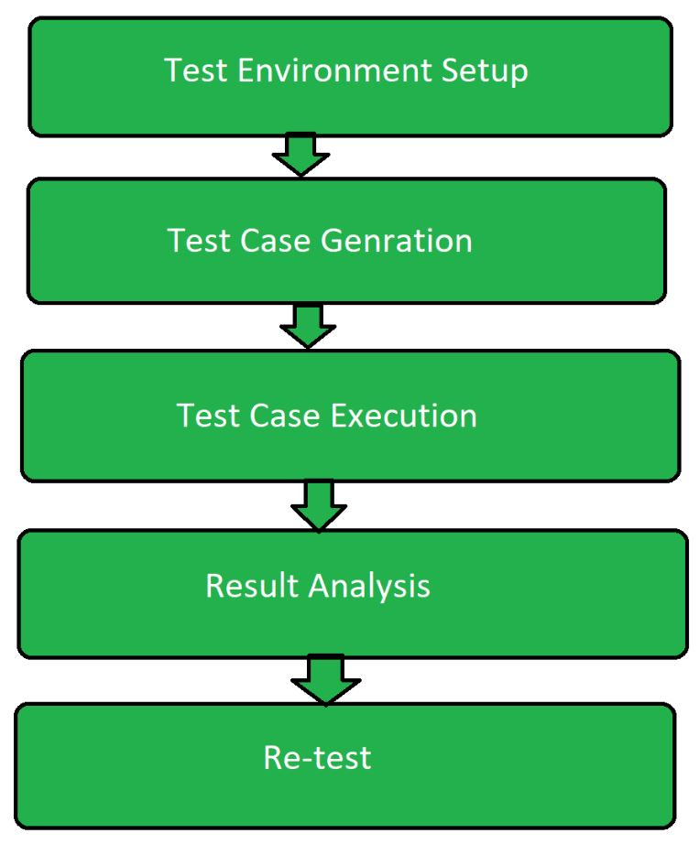

Slide 55
Steps involved in the Error Handling testing: Following are the steps involved in the error handling testing:
1. Test Environment Set Up: Test environment is set according to the software testing technique so that the testing process can run smoothly. This step includes planning for the testing. System which is going to be tested is made sure have less significant data as there might be crash problem in the system during testing.
2. Test Case Generation: In this software testing test case generation is nothing but making different test cases which may cause error. Suppose a software operates on fractions then setting the denominator of the fractions as zero. Test case generation is associated with the developing team as without knowing the internal code, test cases can’t be designed.

Slide 56
3. Test Case Execution: After the test case generation, real testing process begins. This is the most prominent part of the testing process. It includes the running the program over the test case generated.
4. Result and Analysis: After the execution of the test case, its result is analyzed. It includes the checking of the inconsistency in the expected output for the generated test case. There might be a chance of the program going into an infinite loop which may lead up to software failure.
5. Re-test: If the testing is failed then after the analysis once more all the above steps are performed to test the system. It also includes the testing of the system under new test cases generated recently.

Slide 58
Advantages of Error handling testing:
It helps in construction of an error handling powered software.
It makes the software ready for all circumstances.
It develops the exception handling technique in the software.
It helps is maintenance of the software.
Disadvantages of the Error handling testing
It is costly as both the developing and testing team is involved.
It takes lot of time to perform the testing operations.

Slide 59
Characteristics of modern tools in software testing
Some characteristics of modern tools in software testing are:
1. They have an improved speed.
2. They are more efficient and accurate.
3. They are easy to use.
4. They can be automated.
Following are characteristics of modern testing tools
It should use one or more testing strategy for performing testing on host as well as on target platform.
It should support GUI based test preparation.
It should provide complete code coverage and create test documentation in various formats (HTML/DOC/RTF...).
These tools should able to adopt the underlying hardware.
It should be easy to use. 6. Finally it should provide a clear report on test case, steps, test case status (PASS/FAIL).

Slide 60
Modern Software Testing Tools
Modern software testing tools encompass a wide array of solutions for various testing needs, including automation, performance, and mobile testing. Popular choices include Selenium for web application testing, Appium for mobile app testing, and Cypress for modern web applications. Additionally, tools like Test Complete, Lambda Test, and Browser Stack offer comprehensive testing capabilities, while Cucumber supports Behavior-Driven Development.
OR
Modern testing tools in software testing encompass a variety of automation frameworks, platforms, and techniques to enhance efficiency and effectiveness in the software development lifecycle. These tools support various testing types like functional, performance, security, and UI, and include popular choices such as Selenium for web application testing, Appium for mobile app testing, and Cypress for end-to-end testing.

Slide 61
Key Characteristics Modern Software Testing Tools :-
The characteristics of a modern test process scan be summarized in goal orientated, flexible and fast.
1. Automation:
Modern tools automate repetitive tasks, freeing up testers to focus on more complex aspects of testing.
2. Integration:
They integrate with CI/CD pipelines, version control systems, bug-tracking tools, and other development tools, streamlining the testing process.
3. Versatility:
They support a wide range of technologies, including web, mobile, desktop, and hybrid applications.
4. Cross-Platform Compatibility:
They support multiple browsers, operating systems, and devices, ensuring comprehensive testing coverage.
5. Script less Automation:
Some tools offer script less automation, allowing testers to create test cases without coding knowledge.

Slide 62
5. AI-Powered Features:
Many tools utilize AI to automate test case design, execution, and analysis, improving efficiency and accuracy.
6. Comprehensive Reporting:
They provide real-time reporting, detailed analytics, and customizable dashboards to track progress and identify issues.
7. Scalability:
They can handle large-scale testing projects, supporting parallel execution and distributed testing.
8. Collaboration:
They often offer role-based access and collaboration features, facilitating teamwork among testers, developers, and stakeholders.
9. Test Management:
They provide centralized test case and test cycle management, allowing for efficient planning, execution, and tracking of testing activities.

Slide 63
Key Modern Testing Tools:
1. Web Application Testing:
Selenium: A widely-used, open-source framework for automating web browsers and testing web applications.
Cypress: A modern, end-to-end testing framework specifically designed for modern web applications.
Katalon Studio: A comprehensive platform for web application testing, offering a low-code approach.
Test Complete: A robust solution for creating and executing UI tests for web, desktop, and mobile applications.
Play wright: A versatile framework for automating web and mobile browsers, offering cross-platform compatibility.

Slide 64
2. Mobile Application Testing:
Appium: A popular framework for automating native, hybrid, and mobile web apps on Android and iOS.
Katalon Studio: Can also be used for mobile application testing, offering cross-platform automation.
3. API Testing:
Soap UI: A tool for testing REST, SOAP, and GraphQL APIs, offering functional and performance testing capabilities.
Postman: A popular tool for API testing and development, allowing for testing of various API types.

Slide 65
4. Test Management:
Test Link: A free and open-source test management tool.
Spira Test: A comprehensive test management tool for various testing needs.
QA Touch: A tool that helps manage and organize testing processes.
5. Mobile Compatibility Testing:
Browser Stack: A cloud-based platform for testing web applications across different browsers, devices, and operating systems.
Lambda Test: Another cloud-based testing platform offering browser and mobile testing capabilities.
6. Other Notable Tools:
Cucumber: Supports Behavior-Driven Development (BDD), allowing for clearer and more collaborative test case definitions.
Tricentis Tosca: A powerful test automation platform with a low-code approach.
ACCELQ: An AI-powered, code-free test automation platform for various platforms.

Slide 66
END

